Slide 1
Hypothesis Testing
(Teach p-value only for z-test
rule of p-value is same for all hypothesis tests)
if p-value is less than alpha then reject Ho

Slide 2
Introduction
Researchers are interested in answering many types of questions. For example:
Scientist might want to know whether the earth is warming up.
A physician might want to know whether a new medication will lower a person’s blood pressure.
An educator might wish to see whether a new teaching technique is better than a traditional one.
A retail merchant might want to know whether the public prefers a certain color in a new line of fashion.
Automobile manufacturers are interested in determining whether seat belts will reduce the severity of injuries caused by accidents.
These types of questions can be addressed through statistical hypothesis testing, which is a decision-making process for evaluating claims about a population.

Slide 3
Three Methods to test statistical Hypothesis
1. The traditional method 2. The P-value method 3. The confidence interval method

Slide 4

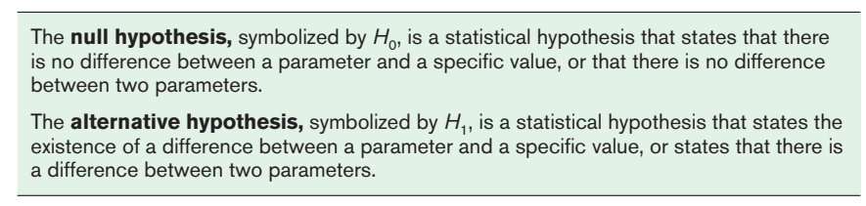
Steps in Hypothesis Testing—Traditional Method
There are two types of statistical hypotheses for each situation: the null hypothesis and the alternative hypothesis.

Slide 5

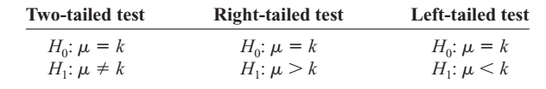
Hypothesis Testing (Contd.)
To state hypotheses correctly, researcher must translate the conjecture or claim from words into mathematical symbols. The basic symbols used are as follows:
The null and alternative hypotheses are stated together, and the null hypothesis contains the equals sign, as shown (where k represents a specified number).

Slide 6
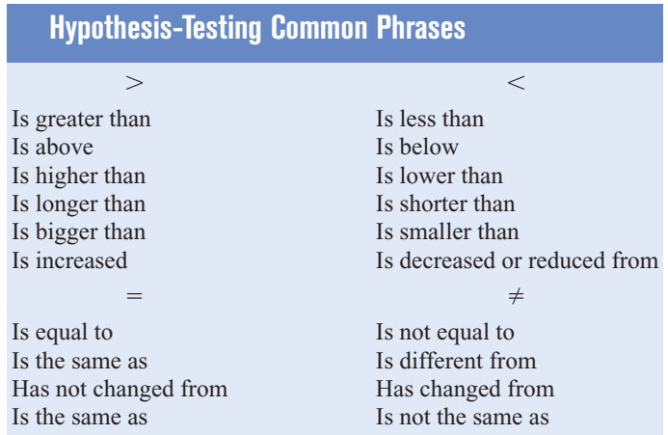

Slide 7
State the null and alternative hypotheses for each conjecture
An engineer hypothesizes that the mean number of defects can be decreased in a manufacturing process of compact disks by using robots instead of humans for certain tasks. The mean number of defective disks per 1000 is 18.
A psychologist feels that playing soft music during a test will change the results of the test. The psychologist is not sure whether the grades will be higher or lower. In the past, the mean of the scores was 73.
A real estate agent claims that 60% of all private residences being built today are 3bedroom homes. To test the claim, a large sample of new residences are inspected; the proportion of these homes with 3 bedrooms is recorded and used as out test statistic state the null & alternative hypotheses.
Notes:
Null: Mean=18 & H1: Mean <18
Null: Mean = 73 & H1: Mean not equal to 73
Null: p=0.6 & H1: P not equal to 0.6.

Slide 8
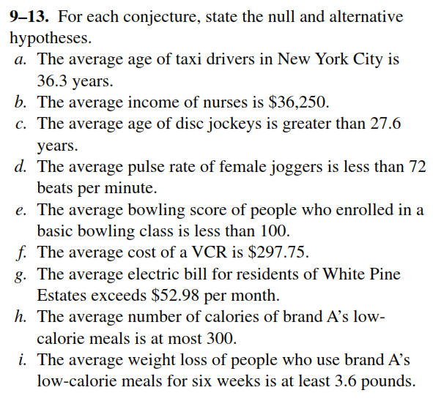

Slide 9
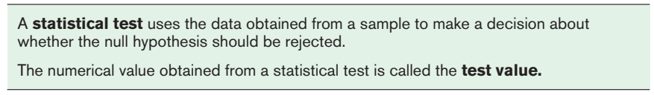
Hypothesis Testing (Contd.)
After stating the hypothesis, the researcher designs the study. The researcher selects the correct statistical test, chooses an appropriate level of significance, and formulates a plan for conducting the study.

Slide 10

4 types of decisions
In the hypothesis-testing situation, there are four possible outcomes.
P(Type-I) = Level of significance
Ho True
Ho False
Error
(Type – I)
Correct Decision
Reject Ho
Correct Decision
Error
(Type – II)
Do not reject Ho
P(Type-II) = β
Notes:
The level of significance is the maximum probability of committing a type I error.

Slide 11
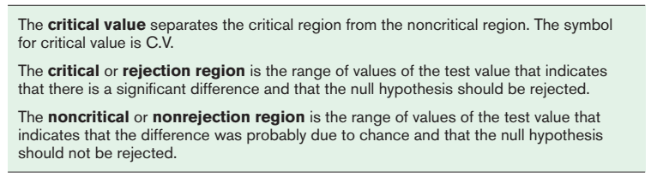
Hypothesis Testing (Contd.)

Slide 12

Hypothesis-testing situation in a Jury Trial
In a jury trial, there are four possible outcomes. The defendant is either guilty or innocent, and he or she will be convicted or acquitted.
Next, the evidence is presented in court by the prosecutor, and based on this evidence, the jury decides the verdict, innocent or guilty.

Slide 13
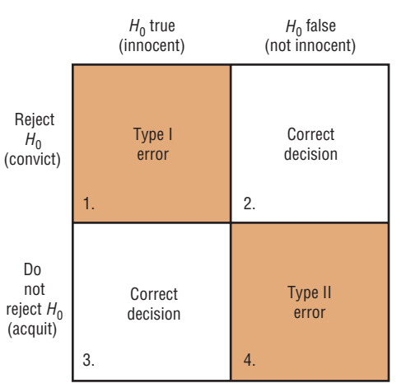
Jury trial (Results of trial)

Slide 14
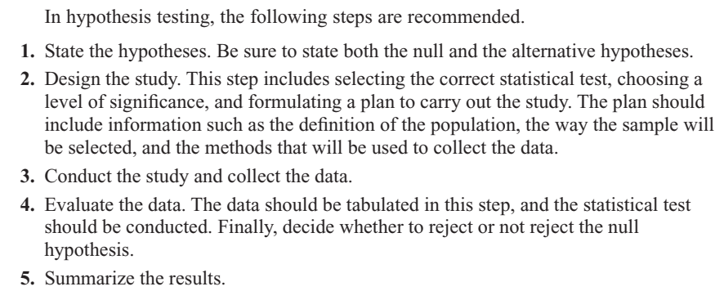
Steps in Hypothesis Testing (summary)

Slide 15
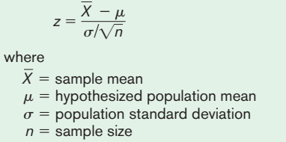
Z-test for mean
The z test is a statistical test for the mean of a population. It can be used when n > 30, or when the population is normally distributed and σ is known. The formula for the z test is

Slide 16
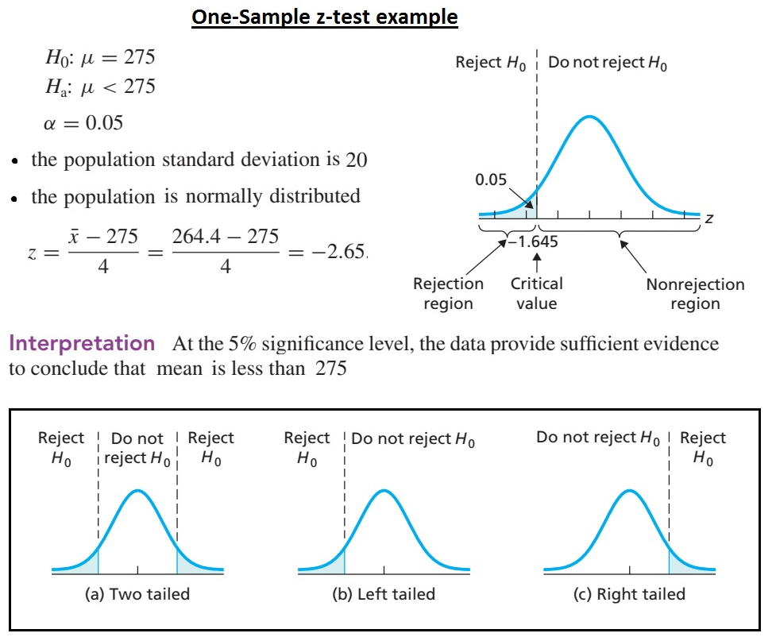

Slide 17
Example # 01 – 02
An electrical firm manufactures light bulbs that have a length of life that is approximately normally distributed with a mean of 1600 hours and a standard deviation of 80 hours. Test the hypothesis that µ = 1600 hours against alternative µ ≠ 1600 hours if a random sample of 30 bulbs has an average life 1576 hours. Use a 0.01 level of significance.
A sample of 16 observations is taken from a normal population whose standard deviation σ = 30. The mean is computed as 110. Test the hypothesis that µ = 100 against the alternative µ > 100 at 0.05 level of significance.
Level of Significance | 0.10 | 0.05 | 0.01
H₁: µ > µ_{o} or µ < µ_{o} | +1.28, - 1.28 | +1.64, -1.64 | +2.33, -2.33
H1: µ ≠ µ_{o} | +1.64, -1.64 | +1.96, -1.96 | +2.58, - 2.58

Slide 18
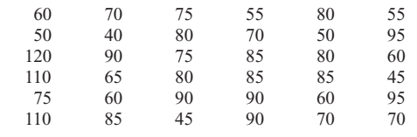
Example # 03
Level of Significance | 0.10 | 0.05 | 0.01
H₁: µ > µ_{o} or µ < µ_{o} | +1.28, - 1.28 | +1.64, -1.64 | +2.33, -2.33
H1: µ ≠ µ_{o} | +1.64, -1.64 | +1.96, -1.96 | +2.58, - 2.58
A researcher claims that the average cost of men’s athletic shoes is less than $80. He selects a random sample of 36 pairs of shoes from a catalog and finds the following costs (in dollars). (The costs have been rounded to the nearest dollar.) Is there enough evidence to support the researcher’s claim at a 0.10? Assume σ =19.2.
Notes:
Z=-1.56, Reject Ho. Xbar=75 ; p-value=0.0594

Slide 19
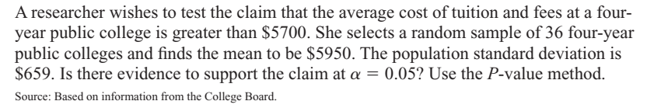
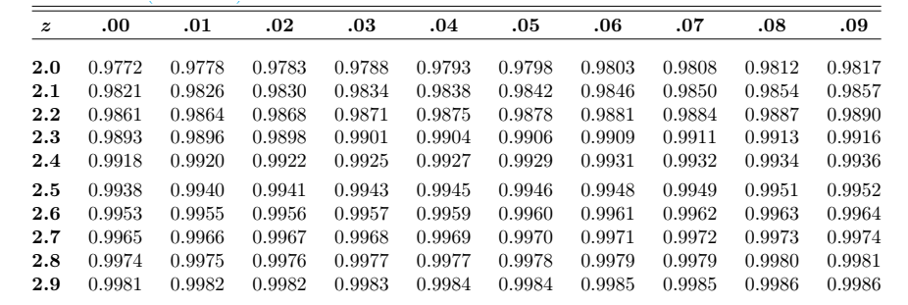
Example # 04
Notes:
Z=2.28 p-value=1 – 0.9887 = 0.0113, Reject Ho

Slide 20
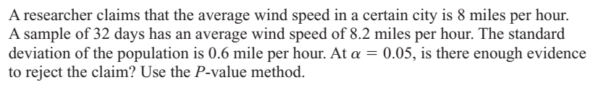
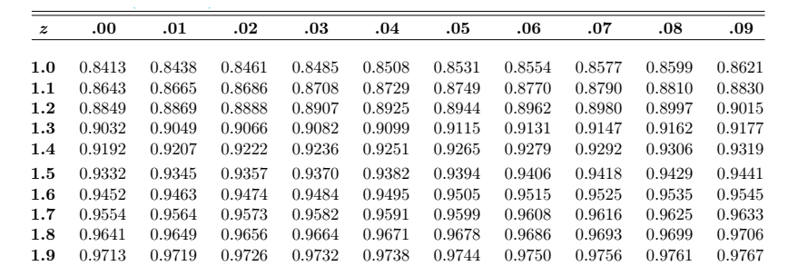
Example # 05
Notes:
Z=1.89; p-value= 1 – 0.9706 = 0.0294 ; since two tail test therefore 2(0..0294) = 0.0588 Accept Ho

Slide 21
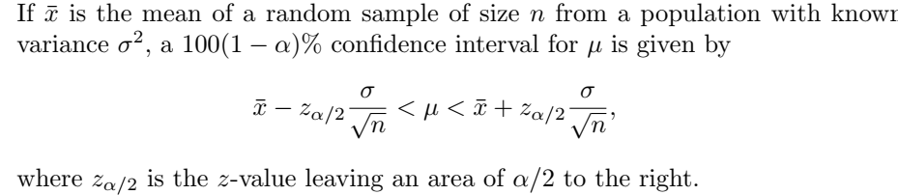
Confidence Interval on µ when σ is known

Slide 22
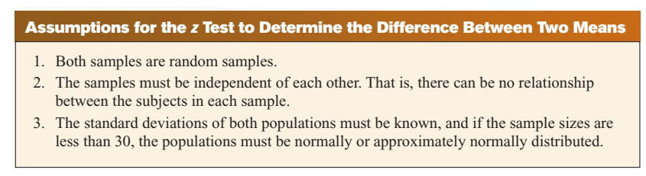
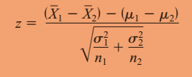
Test of Difference between two means

Slide 23
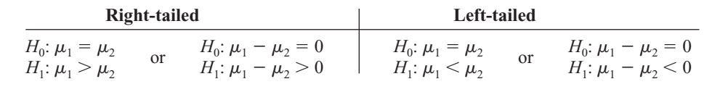
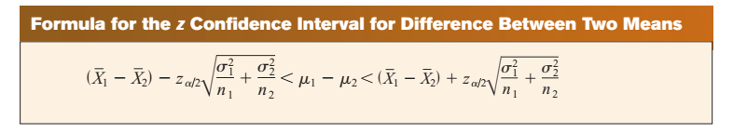
Test of Difference between two means (Contd.)

Slide 24
Example # 06
Hotel Room Cost: A survey found that the average hotel room rate in New Orleans is $88.42 and the average room rate in Phoenix is $80.61. Assume that the data were obtained from two samples of 50 hotels each and that the standard deviations of the populations are $5.62 and $4.83, respectively. At α = 0.05, can it be concluded that there is a significant difference in the rates?
Find the 95% confidence interval for the difference between the means.
Notes:
Z=7.45, Reject Ho,
95% CI: z(alpha/2) = 1.96; [5.76 < u1 – u2 > 9.86]
Since the confidence interval does not contain zero, the decision is to reject the null hypothesis,

Slide 25
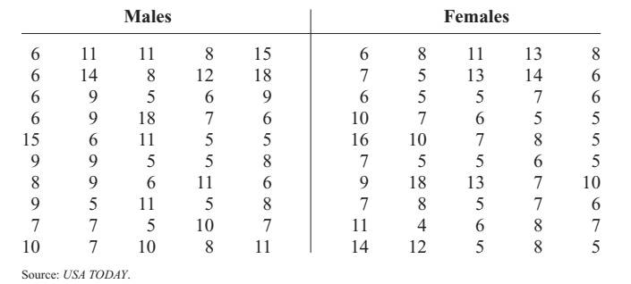
Example # 07
A researcher hypothesizes that the average number of sports that colleges offer for males is greater than the average number of sports that colleges offer for females. A sample of the number of sports offered by colleges is shown. At α = 0.10, is there enough evidence to support the claim? Assume σ₁ and σ₂ = 3.3.
Notes:
Ho: u1=u2; H1: u1>u2, z=1.06 (1 -- 0.8554=0.1446); Xbar1=8.6, Xbar2=7.9
Do not reject Ho.

Slide 26
Example # 05 – 06
A random of sample of size n₁ = 50 taken from normal population with a standard deviation σ1 = 7.35 has sample mean 181. A second sample of size n₂ = 72 taken from a different normal population with σ₂ = 4.81 has sample mean 176. Test the hypothesis at 0.05 level of significance that µ₁ = µ₂, vs. µ₁ ≠ µ₂.
A farmer claims that the average yield of wheat of variety A exceeds the average yield of variety B by at least 12 bushels per acre. To test this claim, 50 acres of each variety are planted and grown under similar conditions. Variety A yielded on the average, 86.7 bushels per acre with a standard deviation of 6.28 bushels per acre, while variety B yielded, on the average 77.8 bushels per acre with a standard deviation of 5.61 bushels per acre. Test the farmer’s claim at alpha = 0.01.
Notes:
Example # 06: Z=-2.6 & Z-critical = (+-)2.33
Do not reject Ho

Slide 27
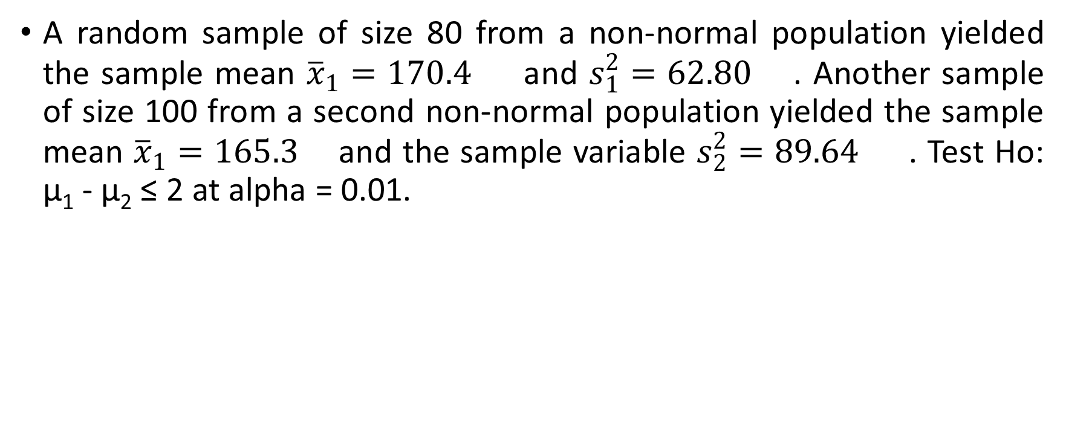
Example # 07

Slide 28
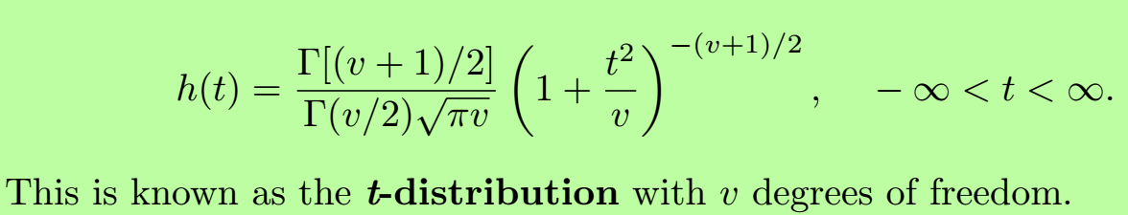
t-test for a Mean (t-distribution)
The t distribution is similar to the standard normal distribution in the following ways.
It is bell-shaped.
It is symmetric about the mean.
The mean, median, and mode are equal to 0 and are located at the center of the distribution.
The curve never touches the x axis.

Slide 29
t-test for a Mean (t-distribution)
The variance is greater than 1.
The t distribution is a family of curves based on the degrees of freedom, which is a number related to sample size.
As the sample size increases, the t distribution approaches the normal distribution.
Notes:
The DF are the number of values that are free to vary after a sample statistic has been computed.

Slide 30
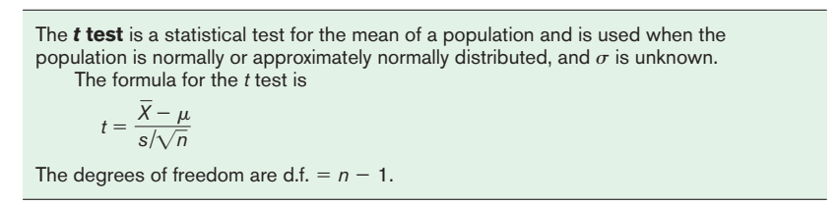
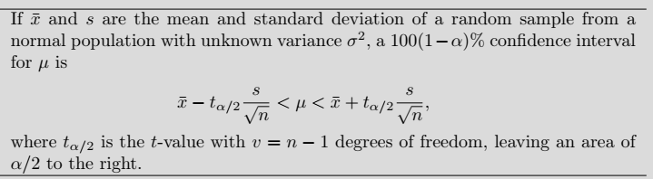
t-test for a Mean
The t-test is defined as:

Slide 31

Example # 08 & 09
Hospital Infections: A medical investigation claims that the average number of infections per week at a hospital in southwestern Pennsylvania is 16.3. A random sample of 10 weeks had a mean number of 17.7 infections. The sample standard deviation is 1.8. Is there enough evidence to reject the investigator’s claim at a 0.05?
Substitute Teachers’ Salaries: An educator claims that the average salary of substitute teachers in school districts in Allegheny County, Pennsylvania, is less than $60 per day. A random sample of eight school districts is selected, and the daily salaries (in dollars) are shown. Is there enough evidence to support the educator’s claim at α 0.10?
Notes:
T=2.46 , T critical = 2.262, Reject Ho
T=-0.264; T criticcal = 0.624 ; do not reject Ho

Slide 32
Example # 10
Jogger’s Oxygen Uptake: A physician claims that joggers’ maximal volume oxygen uptake is greater than the average of all adults. A sample of 15 joggers has a mean of 40.6 milliliters per kilogram (ml/kg) and a standard deviation of 6 ml/kg. If the average of all adults is 36.7 ml/kg, is there enough evidence to support the physician’s claim at α = 0.05?
Notes:
T=2.517 & Reject Ho

Slide 33
Use F-test before pooled and unpooled t-test to decide about equality of variances. (optional)
ratio of two sample variances is F
Larger variance should be in the

Slide 34
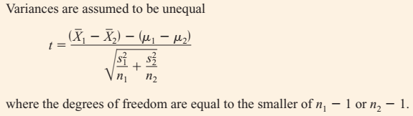
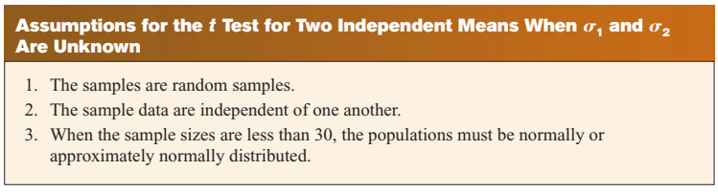
Testing Difference between two mean when σ₁≠ σ₂ (Independent Sample: t-test) unpooled t-test

Slide 36
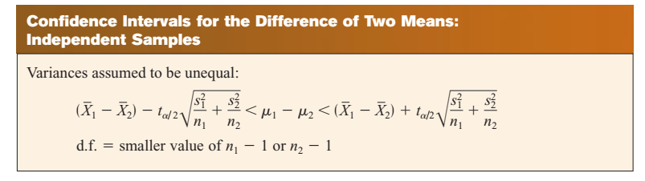

Slide 37
Example # 11
Farm Sizes: The average size of a farm in Indiana County, Pennsylvania, is 191 acres. The average size of a farm in Greene County, Pennsylvania, is 199 acres. Assume the data were obtained from two samples with standard deviations of 38 and 12 acres, respectively, and sample sizes of 8 and 10, respectively. Can it be concluded at α = 0.05 that the average size of the farms in the two counties is different? Assume the populations are normally distributed.
Find the 95% confidence interval .
Notes:
T=-0.57, Tcritical= - 2.365. Do not reject Ho.
95% CI = [ --41.02, 25.02 ]

Slide 39
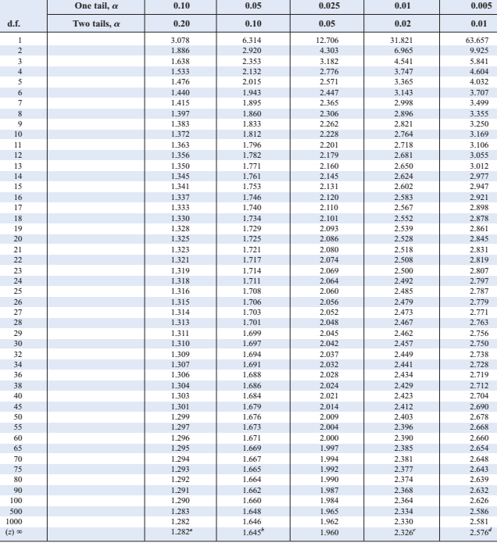

Slide 40
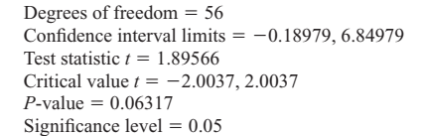
Example # 12
Too Long on the Telephone: A company collects data on the lengths of telephone calls made by employees in two different divisions. The mean and standard deviation for the sales division are 10.26 and 8.56, respectively. The mean and standard deviation for the shipping and receiving division are 6.93 and 4.93, respectively. A hypothesis test was run, and the computer output follows.

Slide 41
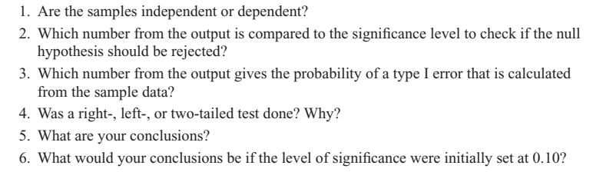
Example # 12 (Contd.)
Independent
We compare the p-value
P-value = P(Type – I)
Two-tailed, since two critical values are given
we fail to reject the null hypothesis & conclude that there is a difference in the lengths of telephone calls.
If the significance level had been 0.10, we would have rejected the null hypothesis,
Notes:
,

Slide 42
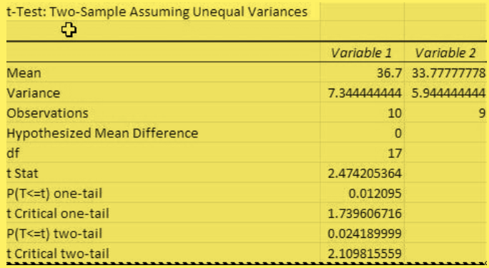
Example # 13
Test the claim that there is no difference between population means based on these sample data.

Slide 43
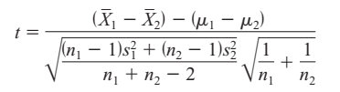
Testing Difference between two mean when σ₁= σ₂ (Independent Sample: t-test) (pooled t-test)
When the variances are assumed to be equal, this formula is used:

Slide 44
Example # 14
Test H_{o}: µ₁ - µ₂ ≤ 3 against H₁: µ₁ - µ₂ > 3 . Let α = 0.10 , σ₁= σ₂ but unknown & normally distributed populations.
Sample I: 51, 42, 49, 55, 46, 63, 56, 58, 47, 39, 47.
Sample II: 38, 49, 45, 29, 31, 35.
Notes:
T-critical = 1.341 df=15, Sp=7.41, t-calculated=2.63, reject Ho.

Slide 45
Testing the Difference Between Two Means: Dependent Samples
Samples are considered to be dependent samples when the subjects are paired, matched or related in some way.
Here are some other examples of dependent samples:
A researcher may want to design an SAT preparation course to help students raise their test scores the second time they take the SAT. Hence, the differences between the two exams are compared.
A medical specialist may want to see whether a new counseling program will help subjects lose weight. Therefore, the preweights of the subjects will be compared with the postweights.

Slide 46

Testing the Difference Between Two Means: Dependent Samples (Contd.)
When the samples are dependent, a special t test for dependent means is used. This test employs the difference in values of the matched pairs. The hypotheses are as follows:

Slide 47
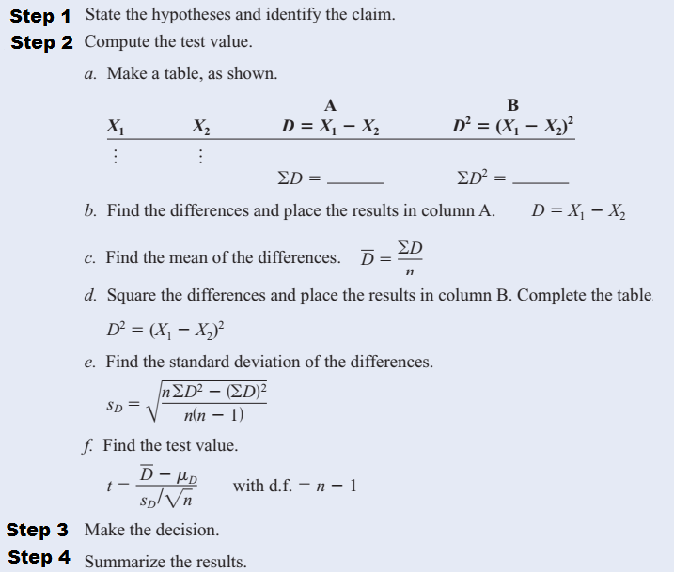

Slide 48
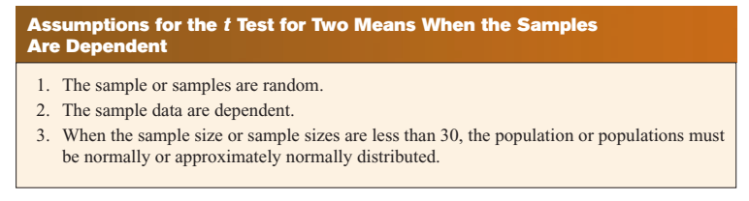

Slide 49
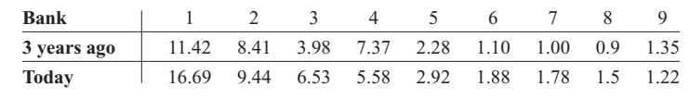
Example # 15
Bank Deposits: A sample of nine local banks shows their deposits (in billions of dollars) 3 years ago and their deposits (in billions of dollars) today. At a 0.05, can it be concluded that the average in deposits for the banks is greater today than it was 3 years ago? Use a 0.05.
Notes:
Ho: Ud=0 & H1: Ud < 0 & df=8 & Dbar= -1.081 & SDd= 1.937
T=-1.67; t-critical=-1.860.’ Do not reject Ho

Slide 50
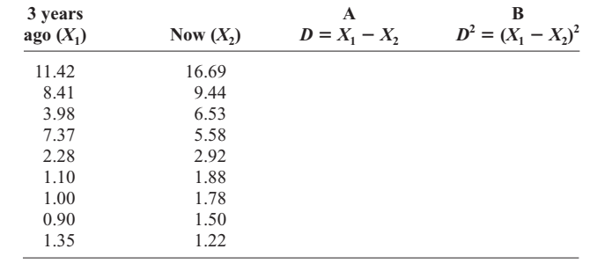
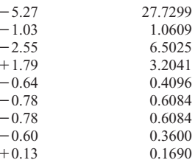
Example # 15 (contd.)
9.73
40.5437
Notes:
T= - 1.67 & t-critical=-1.860; Do not reject Ho Sd=1.937

Slide 51
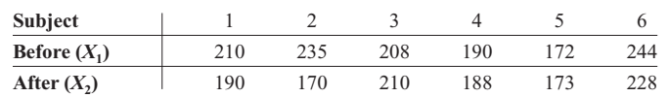
Example # 16
Cholesterol Levels: A dietitian wishes to see if a person’s cholesterol level will change if the diet is supplemented by a certain mineral. Six subjects were pretested, and then they took the mineral supplement for a 6-week period. The results are shown in the table. (Cholesterol level is measured in milligrams per deciliter.) Can it be concluded that the cholesterol level has been changed at a 0.10? Assume the variable is approximately normally distributed.
Notes:
Dbar=16.7; SDd=25.4 t=1.610 t-criticals= +-(2.015)
Do not reject Ho.

Slide 52
I have calculated mean and variance for their differences above in excel.
t-critical = 2.571
t-statistics = 0.0126
we are unable to reject Ho because t-statistics is less than t-critical.
the supplement has no effect in changing cholesterol level.

Slide 54
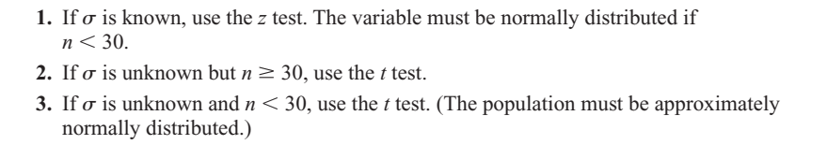
How to select correct test for testing mean
Students sometimes have difficulty deciding whether to use the z test or t test.

